Slide 1
Object-Oriented Programming (OOP)

Slide 2
Abstraction
Abstraction is a way to cope with complexity.
Principle of abstraction:
“Capture only those details about an object that are relevant to current perspective”

Slide 3
Example – Abstraction
Ali is a PhD student and teaches BS students
Attributes
  - Name - Employee ID
  - Student Roll No - Designation
  - Year of Study - Salary
  - CGPA - Age

Slide 4
Example – Abstraction
Ali is a PhD student and teaches BS students
behaviour
  - Study - DevelopExam
  - GiveExam - TakeExam
  - PlaySports - Eat
  - DeliverLecture - Walk

Slide 5
Example – Abstraction
Student’s Perspective
Attributes
  - Name - Employee ID
  - Student Roll No - Designation
  - Year of Study - Salary
  - CGPA - Age

Slide 6
Example – Abstraction
Student’s Perspective
behaviour
  - Study - DevelopExam
  - GiveExam - TakeExam
  - PlaySports - Eat
  - DeliverLecture - Walk

Slide 7
Example – Abstraction
Teacher’s Perspective
Attributes
  - Name - Employee ID
  - Student Roll No - Designation
  - Year of Study - Salary
  - CGPA - Age

Slide 8
Example – Abstraction
Teacher’s Perspective
behaviour
  - Study - DevelopExam
  - GiveExam - TakeExam
  - PlaySports - Eat
  - DeliverLecture - Walk

Slide 9
Example – Abstraction
A cat can be viewed with different perspectives
Ordinary Perspective
  A pet animal with
  Four Legs
  A Tail
  Two Ears
  Sharp Teeth
Surgeon’s Perspective
  A being with
  A Skeleton
  Heart
  Kidney
  Stomach

Slide 10
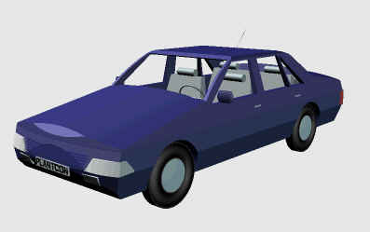
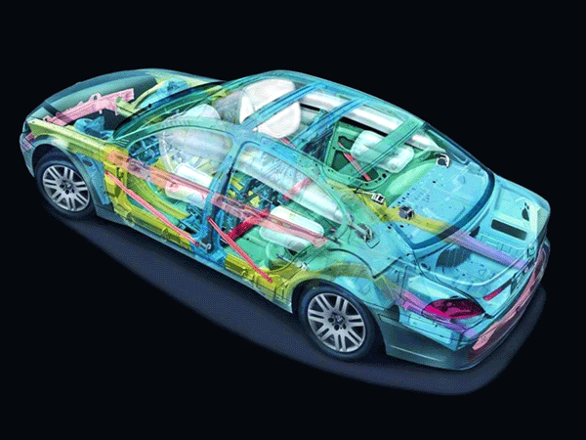
Example – Abstraction
Engineer’s View
Driver’s View

Slide 11
Abstraction – Advantages
Simplifies the model by hiding irrelevant details
Abstraction provides the freedom to defer implementation decisions by avoiding commitment to details

Slide 12
Classes
In an OO model, some of the objects exhibit identical characteristics (information structure and behaviour)
We say that they belong to the same class

Slide 13
Example – Class
Ali studies mathematics
Anam studies physics
Sohail studies chemistry
Each one is a Student
We say these objects are instances of the Student class

Slide 14
Example – Class
Ahsan teaches mathematics
Aamir teaches computer science
Atif teaches physics
Each one is a teacher
We say these objects are instances of the Teacher class

Slide 15
Graphical Representation of Classes
(Class Name)
(Class Name)
(attributes)
(operations)
Suppressed Form
Normal Form

Slide 16
Example – Graphical Representation of Classes
Circle
center
radius
Circle
draw
computeArea
Suppressed Form
Normal Form

Slide 17
Example – Graphical Representation of Classes
Person
name
age
gender
Person
Suppressed Form
eat
walk
Normal Form

